Slide 1


CS 106: Artificial Intelligence
Constraint Satisfaction Problems
Instructor: Ngoc-Hoang LUONG, PhD
University of Information Technology (UIT), VNU-HCM
[These slides were adapted from the slides created by Dan Klein and Pieter Abbeel for CS188 Intro to AI at UC Berkeley. http://ai.berkeley.edu.]
Notes:
Please retain proper attribution, including the reference to ai.berkeley.edu. Thanks!

Slide 2
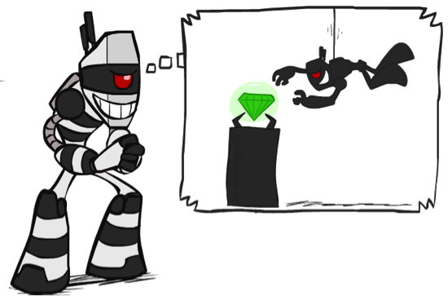

What is Search For?
Assumptions about the world: a single agent, deterministic actions, fully observed state, discrete state space
Planning: sequences of actions
The path to the goal is the important thing
Paths have various costs, depths
Heuristics give problem-specific guidance
Identification: assignments to variables
The goal itself is important, not the path
All paths at the same depth (for some formulations)
CSPs are specialized for identification problems

Slide 3


Varieties of CSPs
Discrete Variables
Finite domains
Size d means O(d^{n}) complete assignments
E.g., Boolean CSPs, including Boolean satisfiability (NP-complete)
Infinite domains (integers, strings, etc.)
E.g., job scheduling, variables are start/end times for each job
Continuous variables
E.g., start/end times for Hubble Telescope observations

Slide 4

Solving CSPs

Slide 5

Standard Search Formulation
Standard search formulation of CSPs
States defined by the values assigned so far (partial assignments)
Initial state: the empty assignment, {}
Successor function: assign a value to an unassigned variable
Goal test: the current assignment is complete and satisfies all constraints
We’ll start with the straightforward, naïve approach, then improve it

Slide 6
Search Methods
What would BFS do?
What would DFS do?
What problems does naïve search have?
 |  | ♛
♛
 |  |  | ♛
 | ♛
Notes:
Demo:
CS188 javascript demos -> source -> exercises -> csps -> CSPs demos -> CSPs demos.html
Settings:
Graph = Simple
Algorithm = Naïve Search
Ordering = None
Filtering = None

Slide 7
BFS?
♛
♛
 | ♛
 | ♛
 | ♛
…
 |  |  | ♛
♛
♛
♛
♛
…
…
…
…
♛
 |  |  | ♛
…
 |  |  | ♛
 |  |  | ♛
♛
♛
♛
…
♛
♛
 | ♛
…
 |  | ♛
♛
 | ♛
…
…
…
 |  | ♛
♛
 |  |  | ♛
…
 |  |  | ♛
 |  |  | ♛
 |  |  | ♛
♛
♛
♛
♛
…
♛
 | ♛
 | ♛
 |  |  | ♛
…
 |  | ♛
♛
 |  |  | ♛
 | ♛
…
♛
♛ |  | ♛
 |  | ♛
…
…
 | ♛
 |  |  | ♛
♛
 |  | ♛
…
 |  |  | ♛
♛
 |  | ♛
♛
…
…
 |  |  | ♛
 |  |  | ♛
 |  |  | ♛
 |  |  | ♛

Slide 8
DFS?
♛
♛
 | ♛
 | ♛
 | ♛
…
 |  |  | ♛
♛
♛
♛
♛
…
♛
 |  |  | ♛
♛
♛
…
♛
 | ♛
…
♛
 |  |  | ♛
♛
♛
 | ♛
…
 |  | ♛
♛
 | ♛
…
♛
 | ♛
♛
♛
♛
♛
♛
 | ♛
…
♛
♛
 | ♛
♛
♛
♛
♛
♛ | ♛
♛
♛
…
♛ |  | ♛
♛
 | ♛
…
 |  | ♛
♛
 |  |  | ♛
 | ♛
 |  | ♛
♛
 | ♛ |  | ♛
♛
♛
♛
 |  |  | ♛

Slide 9
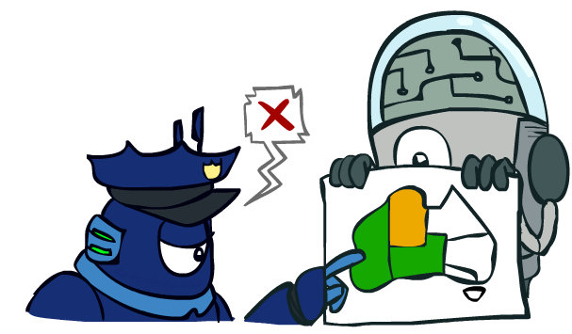
Backtracking Search
Backtracking search is the basic uninformed algorithm for solving CSPs
Idea 1: One variable at a time
Only need to consider assignments to a single variable at each step
Idea 2: Check constraints as you go
i.e. consider only values which do not conflict previous assignments
Might have to do some computation to check the constraints
“Incremental goal test”
Depth-first search with these two improvements
is called backtracking search (not the best name)
Can solve n-queens for n ≈ 25

Slide 10
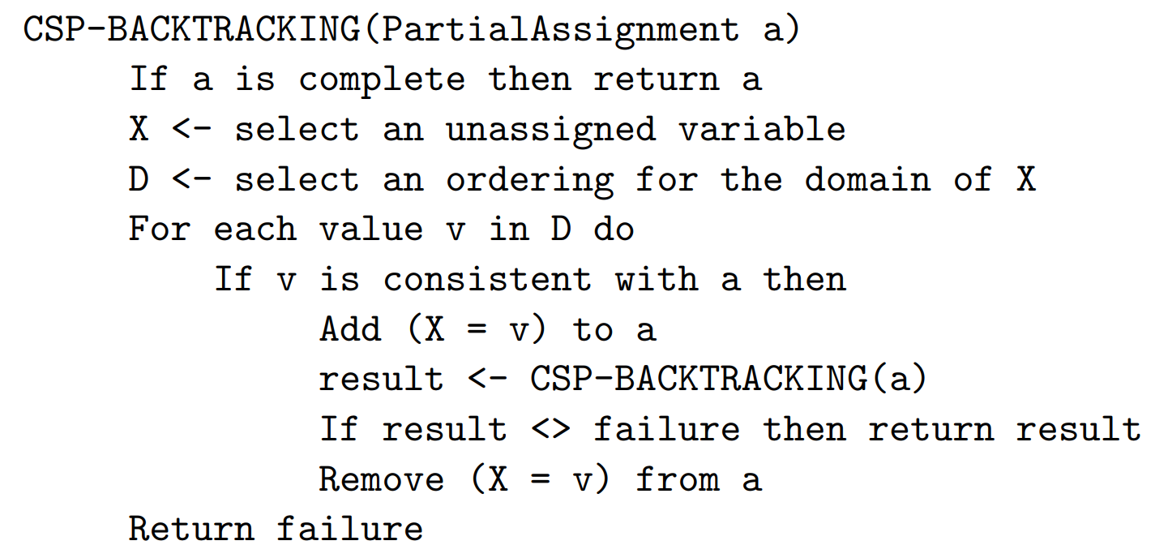
Backtracking Search
Backtracking = DFS + variable-ordering + fail-on-violation
What are the choice points?
https://www.dcc.fc.up.pt/~ines/aulas/1617/IA/cspNew.pdf
Notes:
Demo:
CS188 javascript demos -> source -> exercises -> csps -> CSPs demos -> CSPs demos.html
Settings:
Graph = Simple
Algorithm = Backtracking
Ordering = None
Filtering = None

Slide 11

Improving Backtracking
General-purpose ideas give huge gains in speed
Filtering: Can we detect inevitable failure early?
Ordering:
Which variable should be assigned next?
In what order should its values be tried?
Structure: Can we exploit the problem structure?

Slide 12

Filtering

Slide 13
Filtering: Forward Checking
Filtering: Keep track of domains for unassigned variables and cross off bad options
Forward checking: Cross off values that violate a constraint when added to the existing assignment
Notes:
Demo:
CS188 javascript demos -> source -> exercises -> csps -> CSPs demos -> CSPs demos.html
Settings:
Graph = Simple
Algorithm = Backtracking
Ordering = None
Filtering = Forward Checking

Slide 14
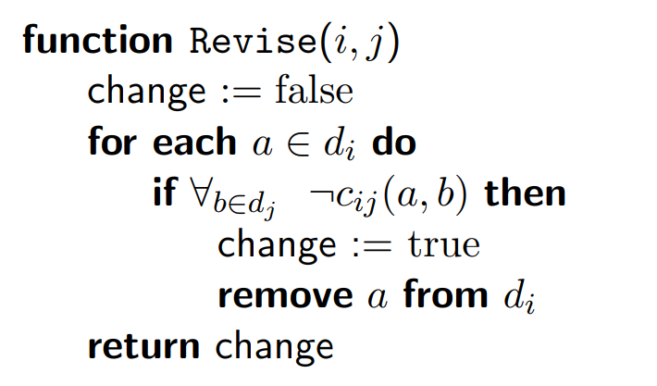
Consistency of A Single Arc
$Revise(i,j)$ removes values from $d_{i}$ without support in $d_{j}$.
https://www.cs.upc.edu/~erodri/webpage/cps/cps.html

Slide 15
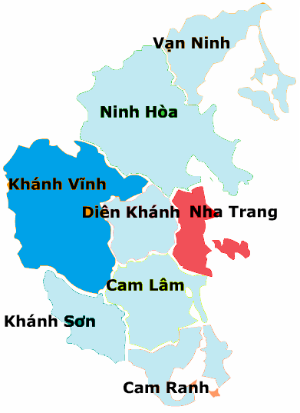
Arc Consistency of an Entire CSP
A simple form of propagation makes sure all arcs are consistent:
Important: If X loses a value, neighbors of X need to be rechecked!
Arc consistency detects failure earlier than forward checking
Can be run as a preprocessor or after each assignment
What’s the downside of enforcing arc consistency?
Vạn Ninh |  |  | Ninh Hòa |  |  | Khánh Vĩnh | Diên Khánh |  |  | Nha Trang | Cam Lâm |  |  | Khánh Sơn |  |  | Cam Ranh |  |  | Trường Sa
Remember: Delete from the tail!

Slide 16
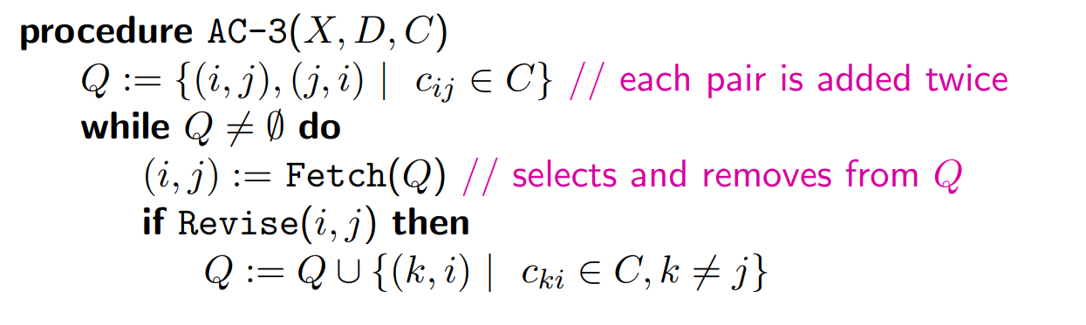
Enforcing Arc Consistency in a CSP
https://www.cs.upc.edu/~erodri/webpage/cps/cps.html
Notes:
Auto-consistency (note initially nothing gets deleted/pruned since there are consistent options for all constraints for initial variable domains)
Flashes whenever something needs to be re-checked

Slide 17

Ordering

Slide 18
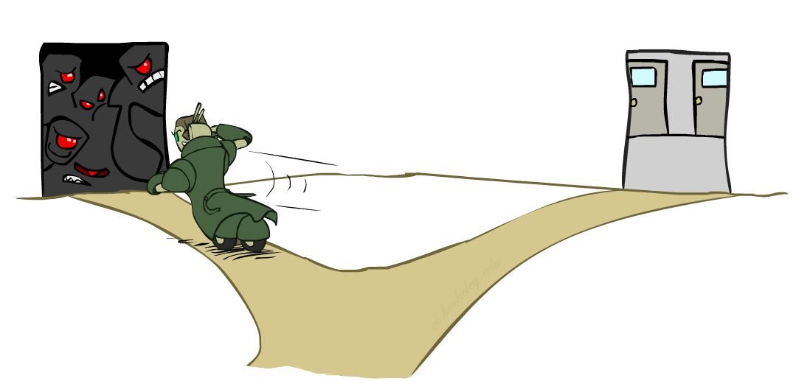
Ordering: Minimum Remaining Values
Variable Ordering: Minimum remaining values (MRV):
Choose the variable with the fewest legal left values in its domain
Why min rather than max?
Also called “most constrained variable”
“Fail-fast” ordering

Slide 19
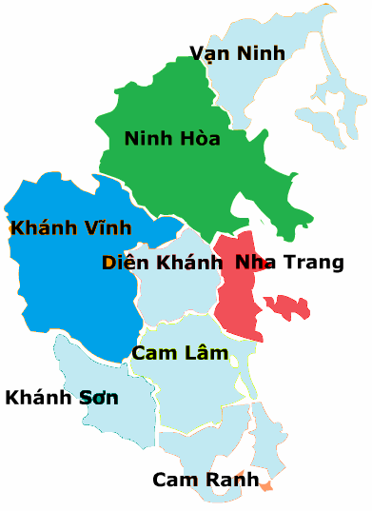
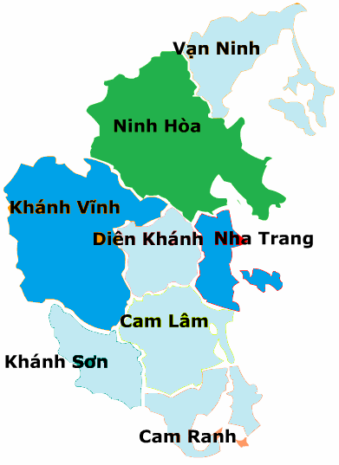
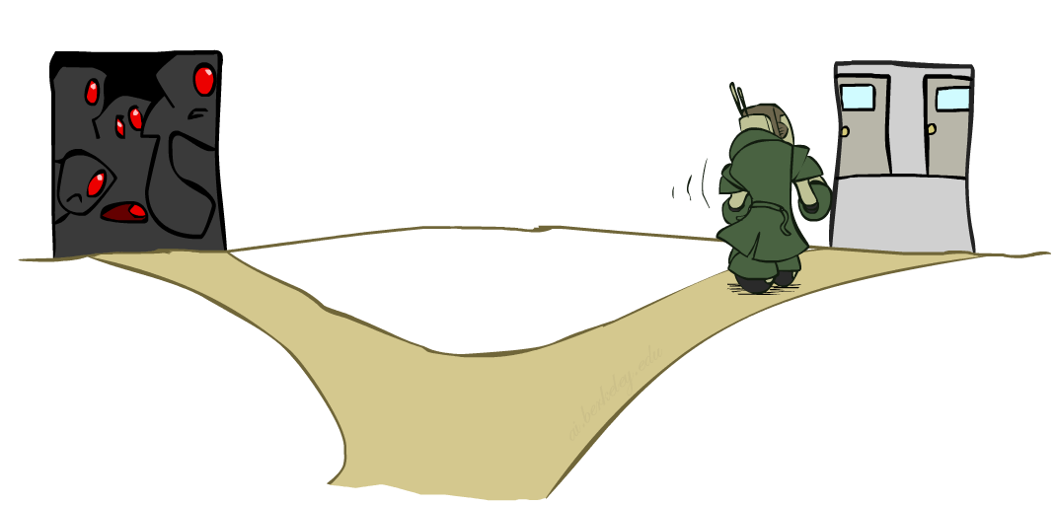
Ordering: Least Constraining Value
Value Ordering: Least Constraining Value
Given a choice of variable, choose the least constraining value
I.e., the one that rules out the fewest values in the remaining variables
Note that it may take some computation to determine this! (E.g., rerunning filtering)
Why least rather than most?
Combining these ordering ideas makes
1000 queens feasible

Slide 20
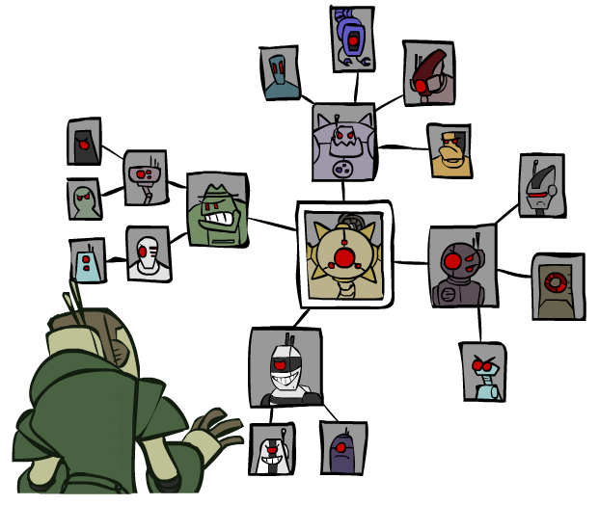
Structure

Slide 21
Problem Structure
Extreme case: independent subproblems
Example: Tasmania and mainland do not interact
Independent subproblems are identifiable as connected components of constraint graph
Suppose a graph of n variables can be broken into subproblems of only c variables:
Worst-case solution cost is O((n/c)(d^{c})), linear in n
E.g., n = 80, d = 2, c =20
2⁸⁰ = 4 billion years at 10 million nodes/sec
(4)(2²⁰) = 0.4 seconds at 10 million nodes/sec

Slide 22
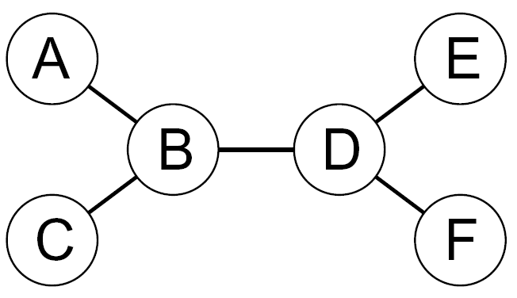
Tree-Structured CSPs
Theorem: if the constraint graph has no loops, the CSP can be solved in O(n d²) time
Compare to general CSPs, where worst-case time is O(d^{n})

Slide 23
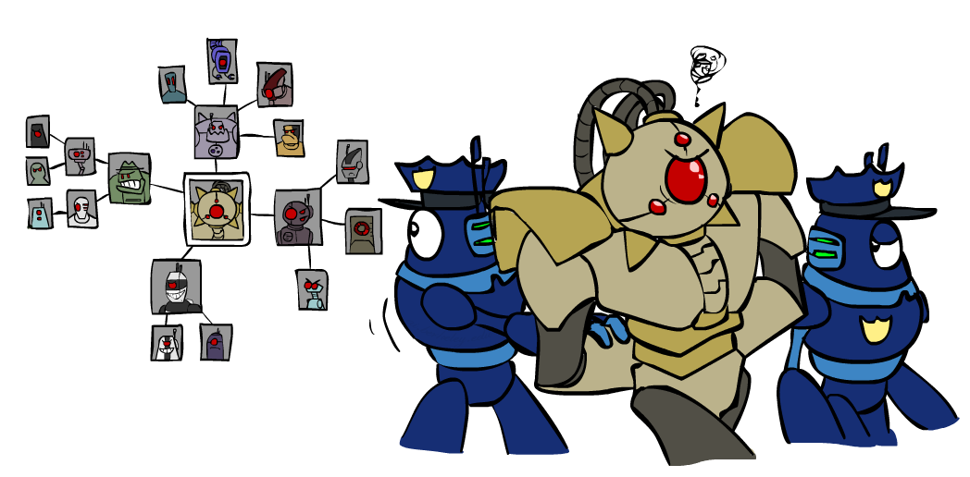
Improving Structure

Slide 24
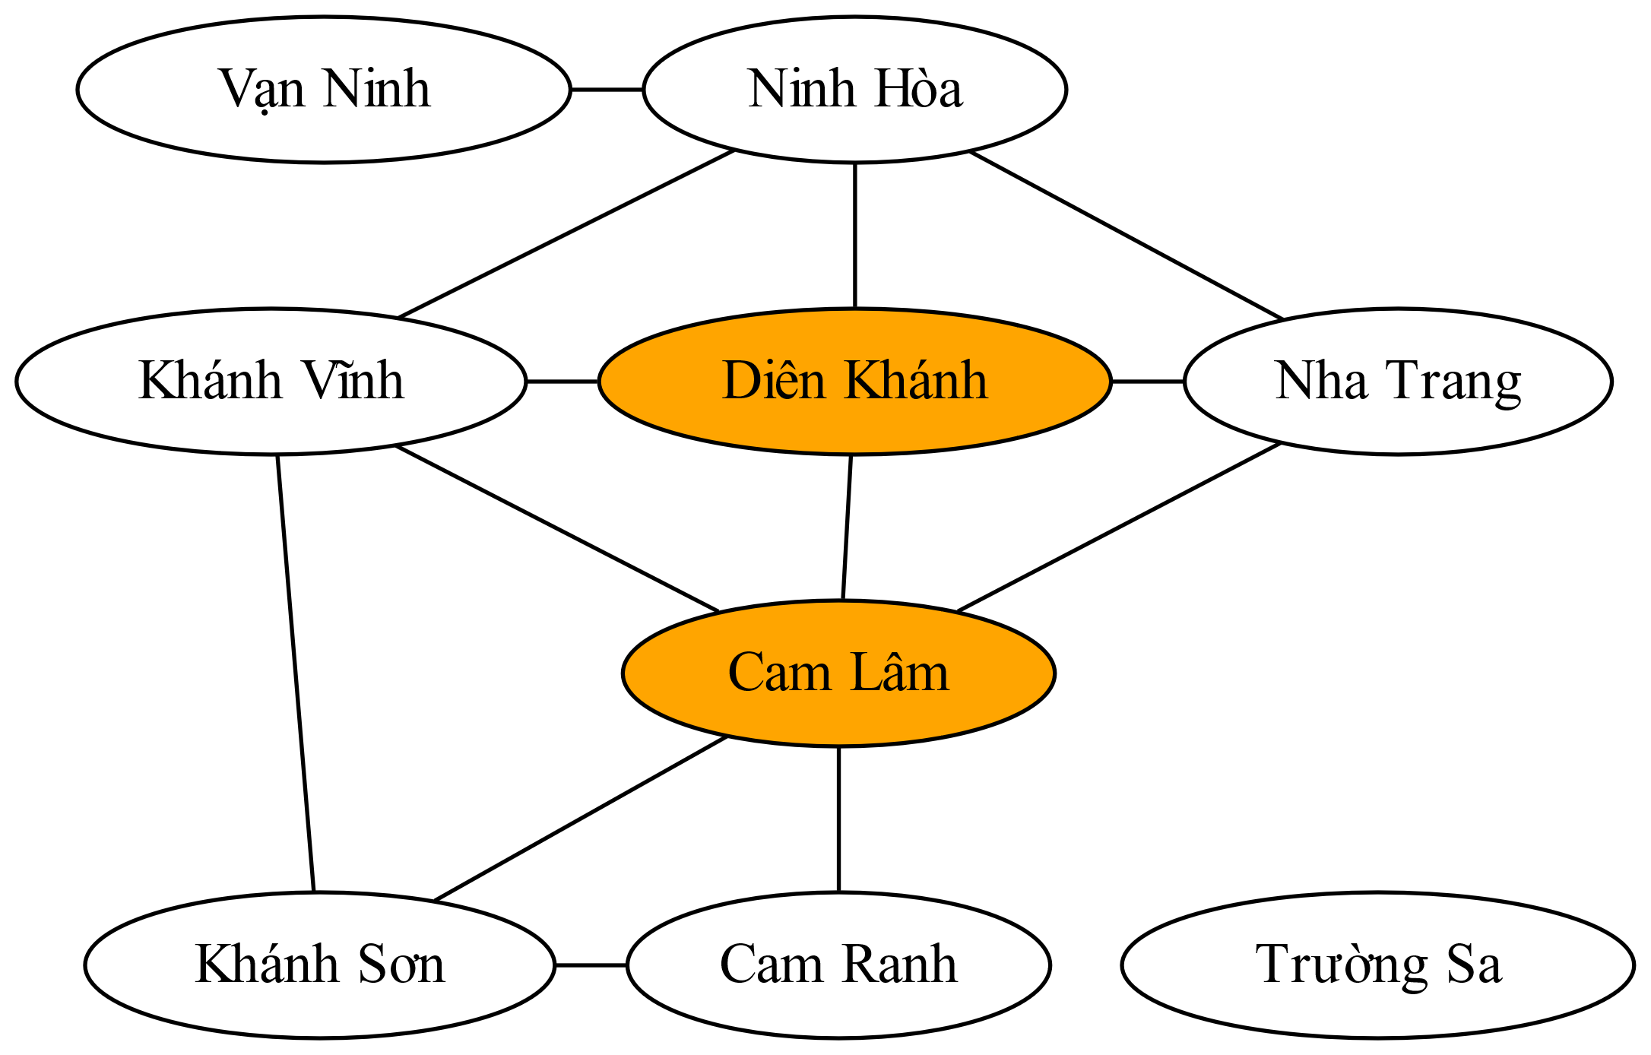
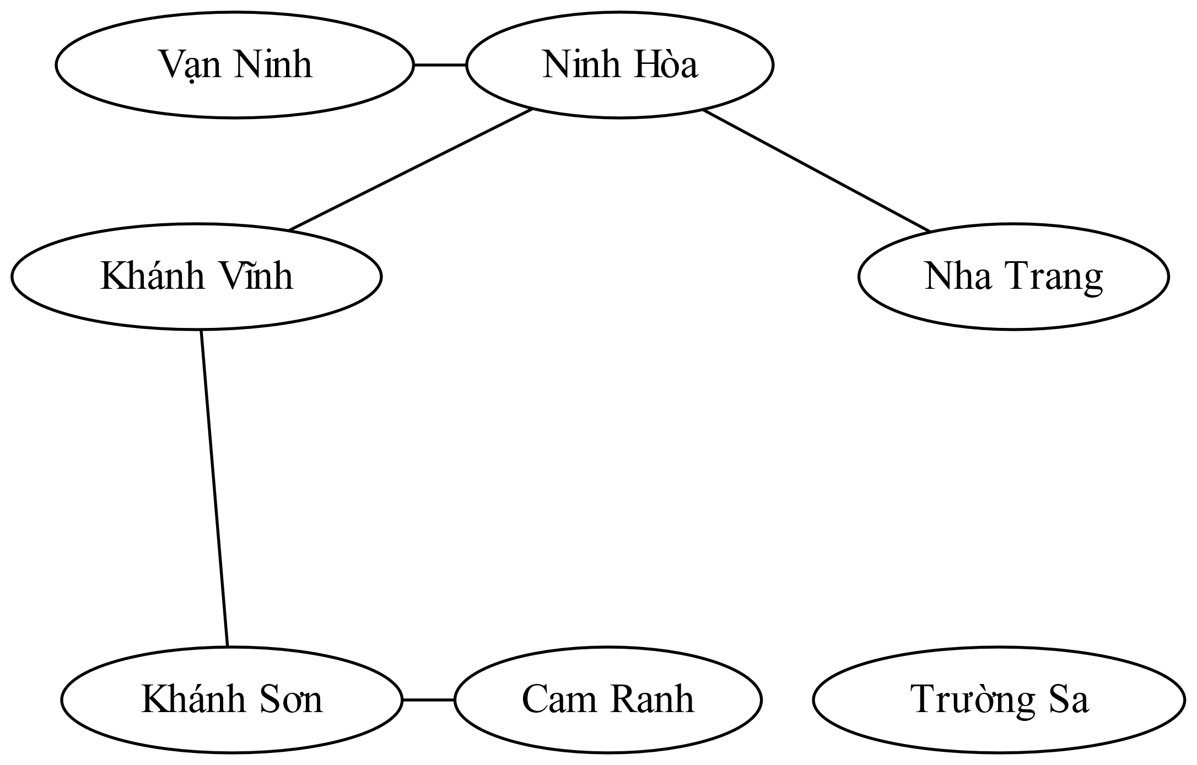
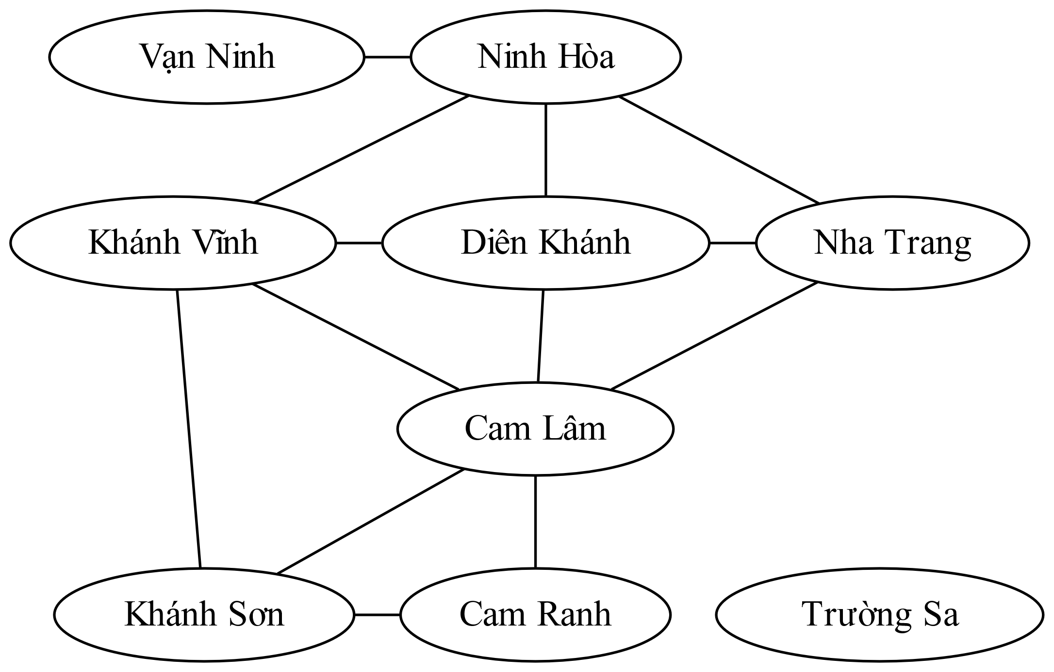
Nearly Tree-Structured CSPs
Conditioning: instantiate a variable, prune its neighbors' domains
Cutset conditioning: instantiate (in all ways) a set of variables such that the remaining constraint graph is a tree

Slide 25
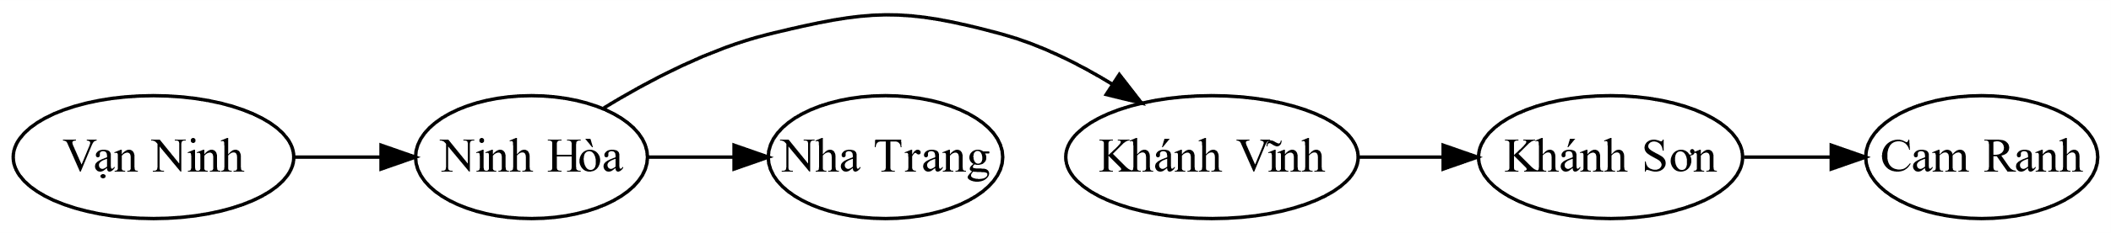
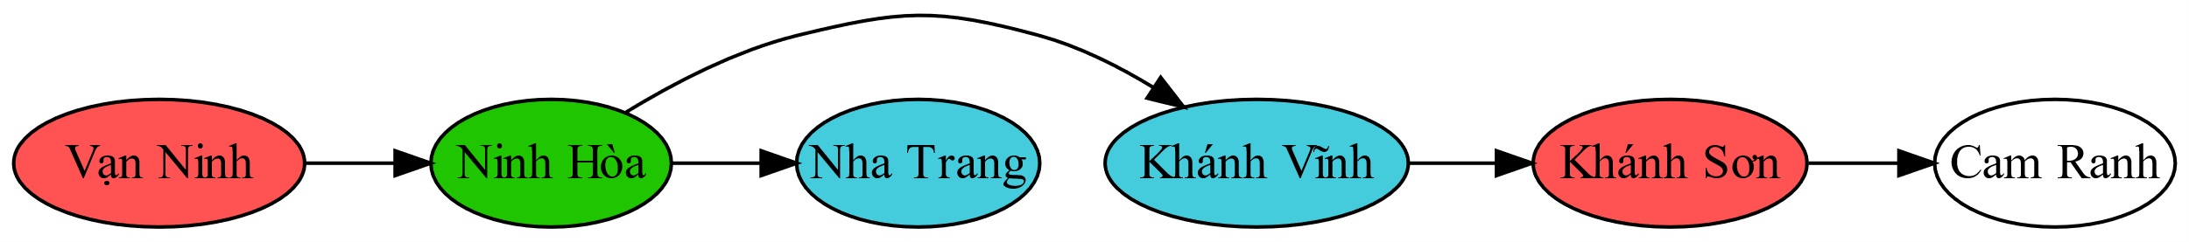
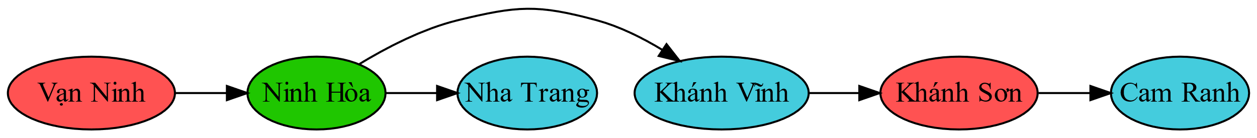
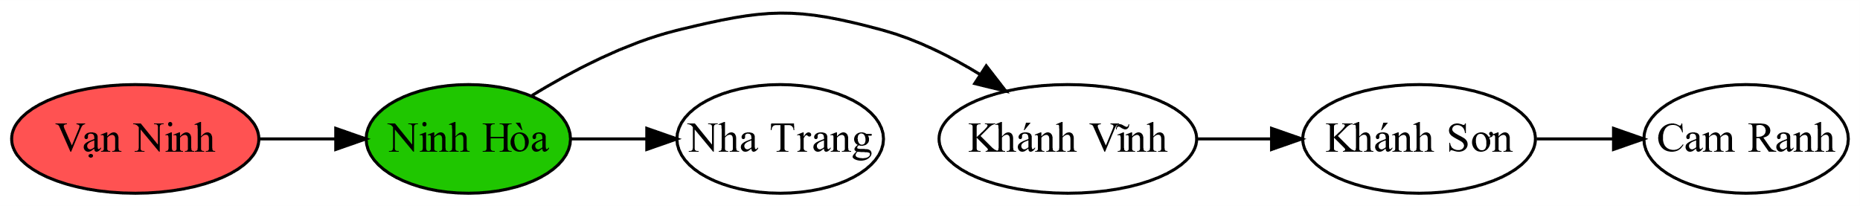
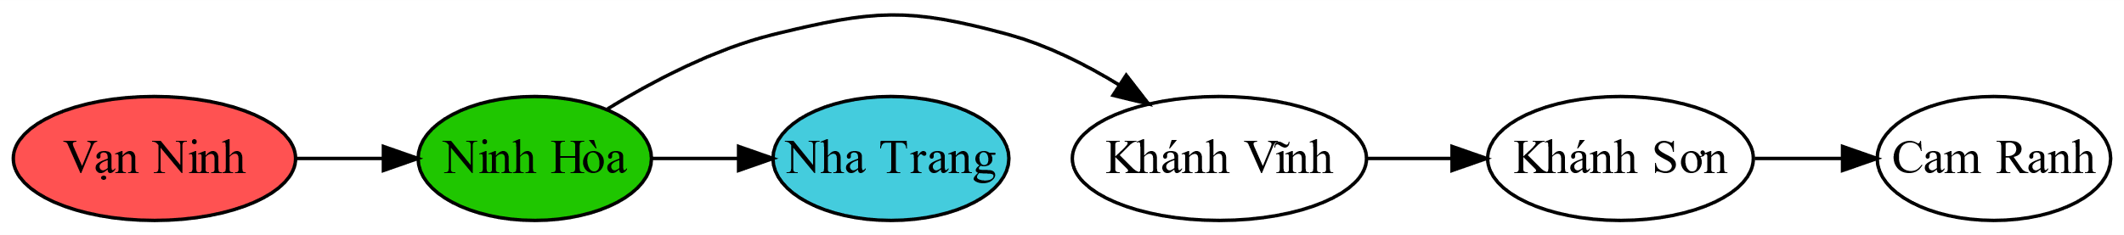
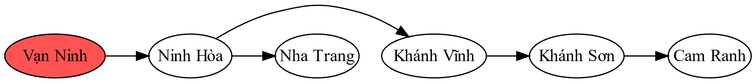
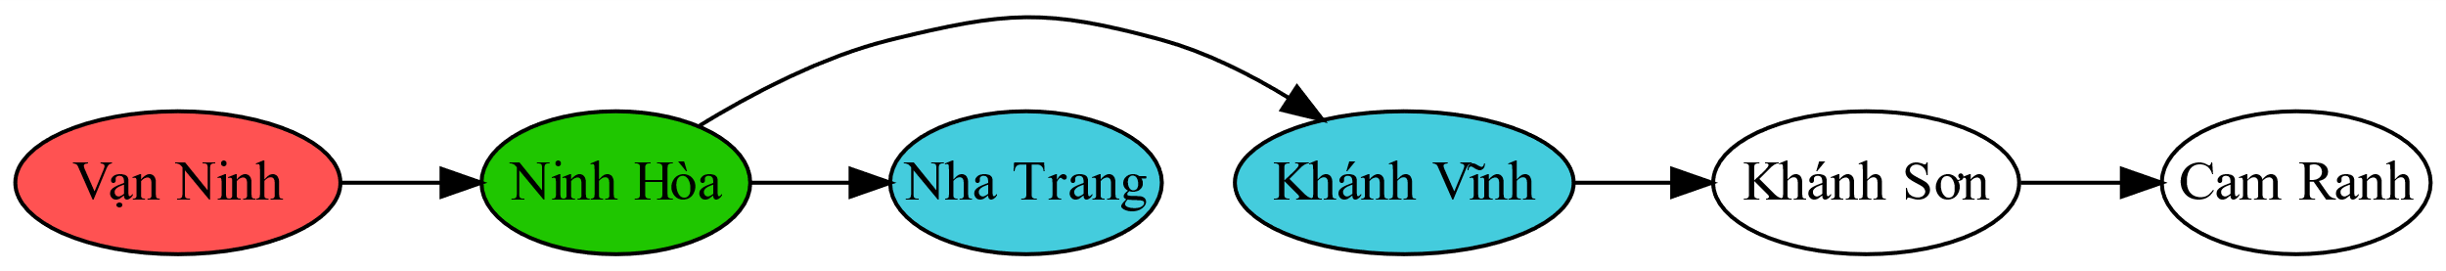
Tree-Structured CSP
Algorithm for tree-structured CSPs:
Order: Choose a root variable, order variables so that parents precede children
Remove backward: For i = n : 2, apply Remove-Inconsistency(Parent(X_{i}),X_{i})
Assign forward: For i = 1 : n, assign X_{i} consistently with Parent(X_{i})
Vạn Ninh |  |  | Ninh Hòa |  |  | Nha Trang |  |  | Khánh Vĩnh |  |  | Khánh Sơn |  |  | Cam Ranh

Slide 26
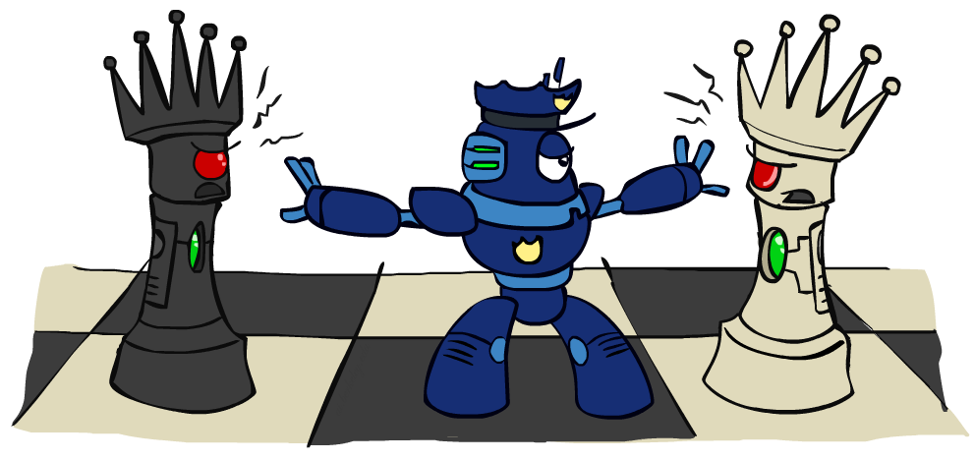
Iterative Improvement

Slide 27
Iterative Algorithms for CSPs
Local search methods typically work with “complete” states, i.e., all variables assigned
To apply to CSPs:
Take an assignment with unsatisfied constraints
Operators reassign variable values
No fringe! Live on the edge.
Algorithm: While not solved,
Variable selection: randomly select any conflicted variable
Value selection: min-conflicts heuristic:
Choose a value that violates the fewest constraints
I.e., hill climb with h(n) = total number of violated constraints

Slide 28
Local Search
Tree search keeps unexplored alternatives on the fringe (ensures completeness)
Local search: improve a single option until you can’t make it better
New successor function: local changes
Generally much faster and more memory efficient (but incomplete and suboptimal)
Pretty much unavoidable when the state is “yourself”

Slide 29
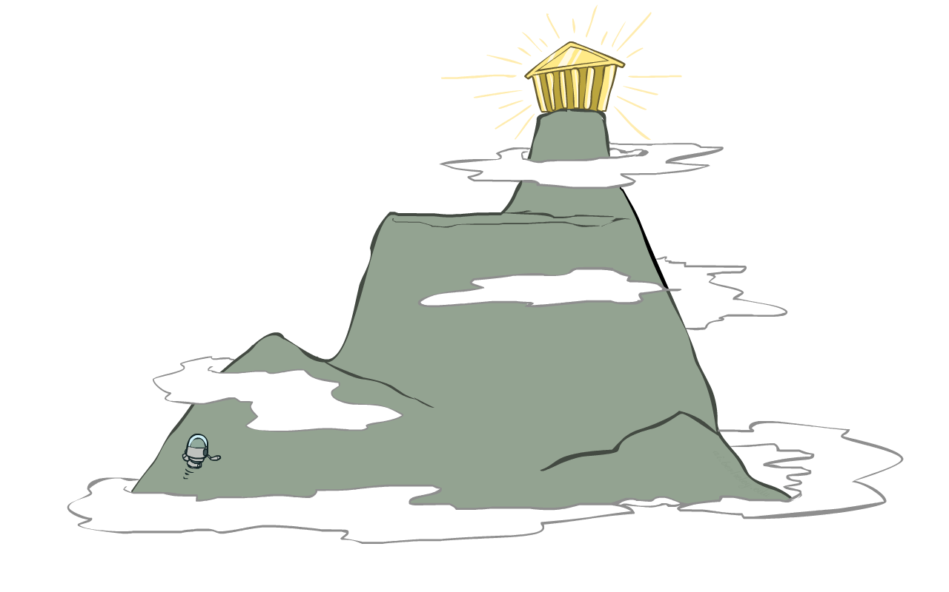
Hill Climbing
Simple, general idea:
Start wherever
Repeat: move to the best neighboring state
If no neighbors better than current, quit

Slide 30
Hill Climbing

Slide 31

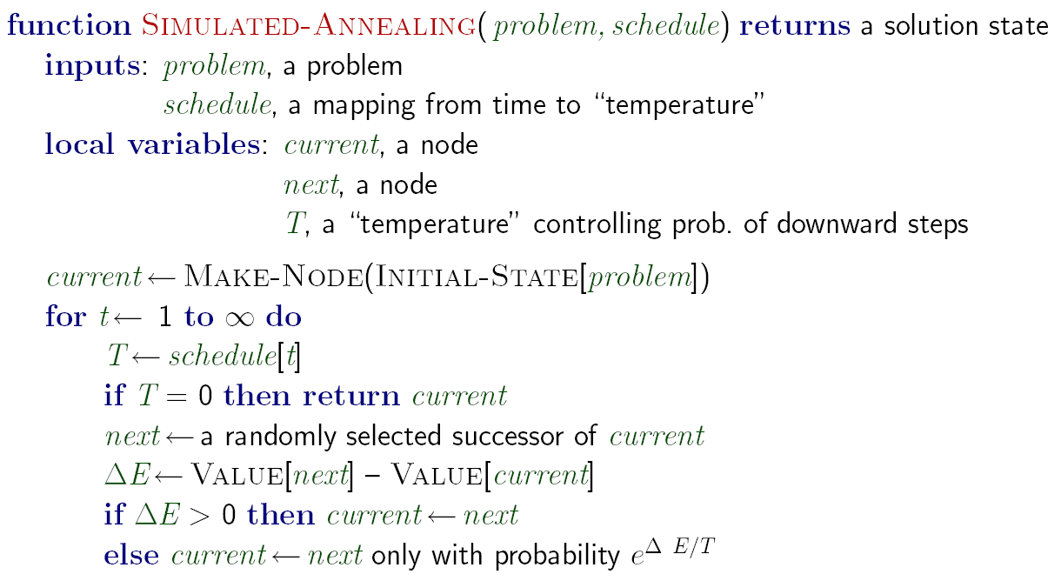
Simulated Annealing
Idea: Escape local maxima by allowing downhill moves
But make them rarer as time goes on

Slide 32
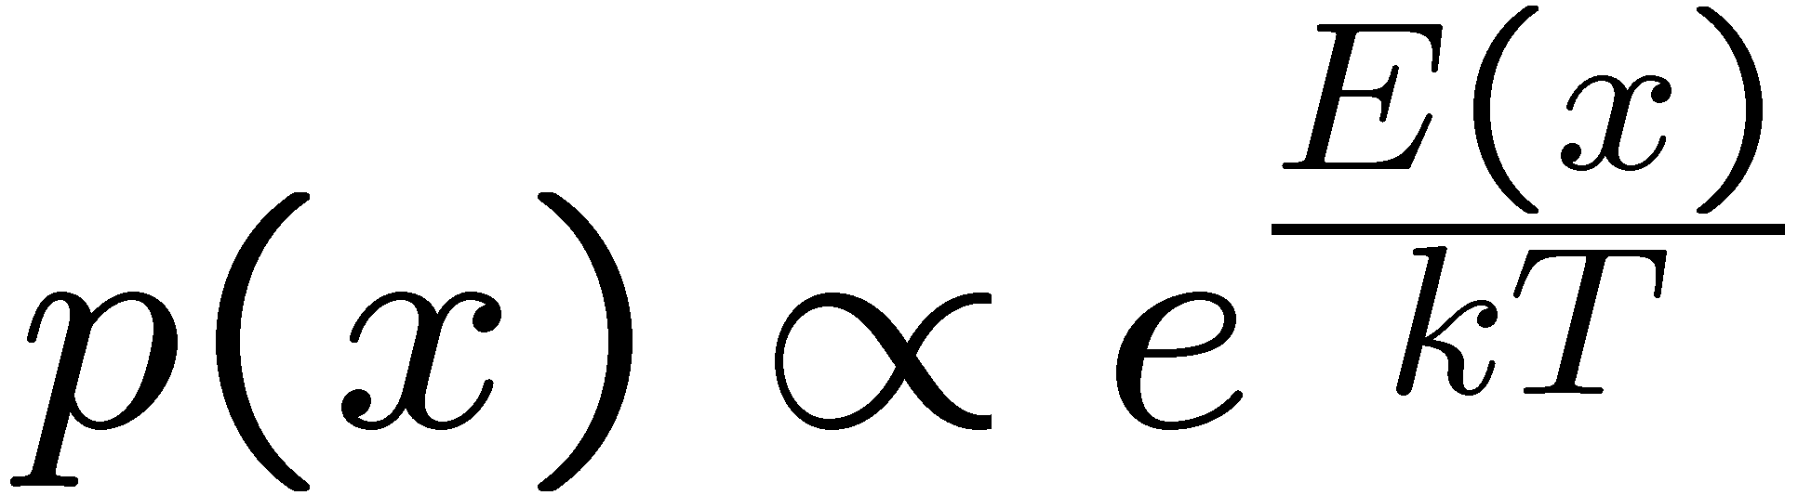
Simulated Annealing
Theoretical guarantee:
Stationary distribution (Boltzmann):
If T decreased slowly enough,
will converge to optimal state!
Is this an interesting guarantee?
Sounds like magic, but reality is reality:
The more downhill steps you need to escape a local optimum, the less likely you are to ever make them all in a row
“Slowly enough” may mean exponentially slowly
Random restart hillclimbing also converges to optimal state…

